Slide 1

Analysing Global Cyber Threat Trends Using Distributed Honeynets: A Comparative Study Over History, Time and Geography
Rihards Ozols C00281617
4th Year project Presentation

Slide 2

Timeline
Week 1-2 Planning and Design
Week 3-5 Build and Test Honeynets
Week 6-7 Deploy honeynet (begin weekly monitoring)
Week 8-20 Run honeypots
Run & Monitor
Weekly checklist & Journal
Historic Research
Week 21-25 Data analysis and Comparison
Week 26-28 Finalization and References

Slide 3
Set up of Logging and Monitoring Design
Tools used for Data collection
How logs are stored and backed up
GeoIP tools used
Create a weekly check list & data collection journal, where I will write down weekly notable events that take place on the honeynets
I’m also going to use the journal to note real world cyber events tied to regions I am monitoring

Slide 4
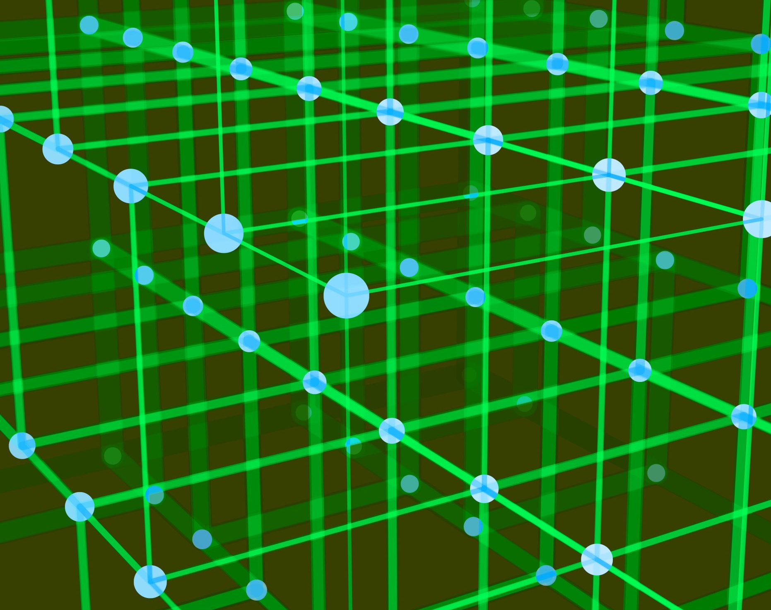
Honeynets Design and Deployment
Determine the optimum config, location and duration of different Honey nets
Decide on the what cloud providers (choosing 3) to use to broaden scope of analysis
Determine low-interaction vs high interaction honeypot
Set honey nets up on two different types of software (Cowrie, Tpot)
Deploy honey nets on decided clouds and ensure they are all identical in their setup

Slide 5

Post-deployment
The honey nets will be deployed for decided number of months
During this period, I will not have much to do as my project is based on the results of the honeynets, However, I'm going to spend this time researching past honeynet projects done in similar geographic regions with similar providers so I can compare my findings with historic data
How the honeynet is performing in regard to attractiveness, coverage, total attack per day/week/month
I will also log and monitor honeynets weekly to ensure early detection of threats, study trends in real-time, ensure intel is still relevant and ensure to keep the data manageable and prevent storage issues
I have also created a checklist that I will go over where I will gather additional data and again ensure a smooth deployment phase

Slide 6

Analyse Data
Analyse the nature, source and frequency of the attacks
Compare different honeynet software (Cowrie, Tpot). Determine which tool is the most efficient etc
Identify trends (attack types, source and destination countries, attack complexity, targeted ports, time patterns regional hotspots etc)

Slide 7
Analyse Data
Analyse Data
Compare cloud providers attack volume and complexity
Compare with previous years, attack types, source and destination countries, attack
complexity, targeted ports, tools used, frequency increasing/decreasing
Determine safest/riskiest countries or cloud to host web services.
Recommend remediation recommendations from findings

Slide 8
Conclusion
This project aims to provide a data-driven understanding of global cyber threats.
This research project will:
Reveal global patterns in cyber attacks - by time, location, and method.
Identify high-risk regions and cloud platforms for hosting services.
Offer practical, evidence-based mitigation strategies.
Contribute valuable threat intelligence to the cybersecurity community.

Slide 9

Thank you!

